Slide 1
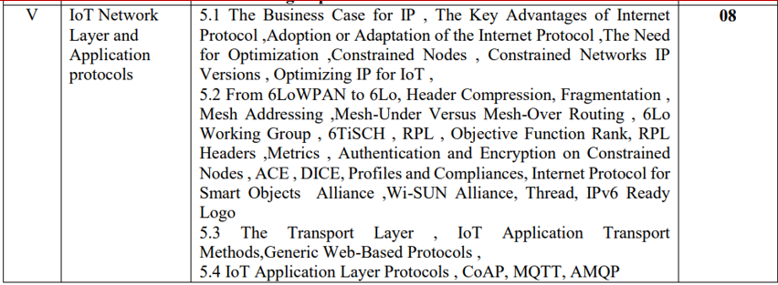

Slide 2
IP as the IoT Network Layer
This chapter is composed of the following sections:
The Business Case for IP: This section discusses the advantages of IP from an IoT perspective and introduces the concepts of adoption and adaptation.
The Need for Optimization: This section dives into the challenges of constrained nodes and devices when deploying IP. This section also looks at the migration from IPv4 to IPv6 and how it affects IoT networks.
Optimizing IP for IoT: This section explores the common protocols and technologies in IoT networks utilizing IP, including 6LoWPAN, 6TiSCH, and RPL.
Profiles and Compliances: This section provides a summary of some of the most significant organizations and standards bodies involved with IP connectivity and IoT.

Slide 3
The Business Case for IP
Data flowing from or to “things” is consumed, controlled, or monitored by data center servers either in the cloud or in locations that may be distributed or centralized.
Dedicated applications are then run over virtualized or traditional operating systems or on network edge platforms (for example, fog computing).
These lightweight applications communicate with the data center servers.
Therefore, the system solutions combining various physical and data link layers call for an architectural approach with a common layer(s) independent from the lower (connectivity) and/or upper (application) layers.
This is how and why the Internet Protocol (IP) suite started playing a key architectural role in the early 1990s.
IP was not only preferred in the IT markets but also for the OT environment. (IT (Information Technology) and OT (Operational Technology) are two key domains in industrial and enterprise systems. While IT manages data and communication, OT controls physical processes and machinery.)

Slide 4
The Key Advantages of Internet Protocol
One of the main differences between traditional information technology (IT) and operational technology (OT) is the lifetime of the underlying technologies and products.
key advantages of the IP suite for the Internet of Things:
Open and standards-based:
The Internet of Things creates a new paradigm in which devices, applications, and users can leverage a large set of devices and functionalities while guaranteeing interchangeability and interoperability, security, and management.
This calls for implementation, validation, and deployment of open, standards-based solutions.
While many standards development organizations (SDOs) are working on Internet of Things definitions, frameworks, applications, and technologies, none are questioning the role of the Internet Engineering Task Force (IETF) as the foundation for specifying and optimizing the network and transport layers.
The IETF is an open standards body that focuses on the development of the Internet Protocol suite and related Internet technologies and protocols.

Slide 5
Versatile:
A large spectrum of access technologies is available to offer connectivity of “things” in the last mile.
Layered IP architecture is well equipped to cope with any type of physical and data link layers.
This makes IP ideal as a long-term investment because various protocols at these layers can be used in a deployment now and over time, without requiring changes to the whole solution architecture and data flow.

Slide 6
Ubiquitous:
All recent operating system releases, from general-purpose computers and servers to lightweight embedded systems (TinyOS, Contiki, and so on), have an integrated dual (IPv4 and IPv6) IP stack that gets enhanced over time.
IP is the most pervasive protocol, supported across the various IoT solutions and industry verticals.

Slide 7
Scalable:
IP has been massively deployed and tested for robust scalability.
Millions of private and public IP infrastructure nodes have been operational for years, offering strong foundations for those not familiar with IP network management.
Adding huge numbers of “things” to private and public infrastructures may require optimizations and design rules specific to the new devices.
IP has proven before that scalability is one of its strengths.

Slide 8
Manageable and highly secure:
Communications infrastructure requires appropriate management and security capabilities for proper operations.
One of the benefits that comes from 30 years of operational IP networks is the well-understood network management and security protocols, mechanisms, and toolsets that are widely available.

Slide 9
Stable and resilient:
IP has been around for 30 years, and it is clear that IP is a workable solution.
IP has a large and well-established knowledge base and, more importantly, it has been used for years in critical infrastructures, such as financial and defense networks.
In addition, IP has been deployed for critical services, such as voice and video, which have already transitioned from closed environments to open IP standards.
Finally, its stability and resiliency benefit from the large ecosystem of IT professionals who can help design, deploy, and operate IP-based solutions.

Slide 10
Consumers’ market adoption:
When developing IoT solutions and products targeting the consumer market, vendors know that consumers’ access to applications and devices will occur predominantly over broadband and mobile wireless infrastructure.
The main consumer devices range from smart phones to tablets and PCs.
The common protocol that links IoT in the consumer space to these devices is IP.

Slide 11
Adoption or Adaptation of the Internet Protocol
To integrate non-IP networks with IP-based networks (such as the internet). Typically, one of two models, adaptation or adoption, is proposed:
Adaptation (Using ALGs for Translation)
Adaptation means keeping the existing non-IP infrastructure but enabling it to communicate with IP-based networks using Application Layer Gateways (ALGs).
ALGs act as translators between different protocols, ensuring data from non-IP devices can be understood by IP networks.
This approach allows gradual transition without replacing existing systems.
Example:
A factory with legacy industrial controllers using Modbus (non-IP) can use an ALG to convert Modbus data into MQTT (IP-based protocol) for cloud processing.

Slide 12
Adoption (Replacing Non-IP Layers with IP-Based Layers)
Adoption means fully transitioning to an IP-based network by replacing all non-IP layers with IP-compatible counterparts.
This simplifies network management and operations because everything follows the same IP standards.
However, it requires upgrading all legacy systems, which can be costly and complex.
Example:
Instead of using an ALG to translate Modbus to MQTT, the factory replaces Modbus devices with IoT-enabled IP-native sensors that directly communicate over MQTT/HTTP.
Adaptation: Use ESP32 with ALGs to bridge LoRaWAN (non-IP) with MQTT (IP).
Adoption: Use ESP32 with Wi-Fi or Ethernet for direct IP-based communication.

Slide 13
Need for Optimization
Internet of Things will largely be built on the Internet Protocol suite.
However, challenges still exist for IP in IoT solutions.
In addition to coping with the integration of non-IP devices, you may need to deal with the limits at the device and network levels that IoT often imposes.
Therefore, optimizations are needed at various layers of the IP stack to handle the restrictions that are present in IoT networks.

Slide 14
why optimization is necessary for IP?
Devices that are very constrained in resources, may communicate infrequently to transmit a few bytes, and may have limited security and management capabilities: This drives the need for the IP adaptation model, where nodes communicate through gateways and proxies.
Devices with enough power and capacities to implement a stripped-down IP stack or non- IP stack: In this case, you may implement either an optimized IP stack and directly communicate with application servers (adoption model) or go for an IP or non-IP stack and communicate through gateways and proxies (adaptation model).
Devices that are similar to generic PCs in terms of computing and power resources but have constrained networking capacities, such as bandwidth: These nodes usually implement a full IP stack (adoption model), but network design and application behaviors must cope with the bandwidth constraints.

Slide 15
Constrained Networks
Constrained networks are often referred to as low-power and lossy networks (LLNs).
Lossy in this context refers to network unreliability that is caused by disruptions in the data flow or packet loss.
LLNs were defined by the IETF’s Routing over Low-Power and Lossy Networks (RoLL) working group when developing the IPv6 RPL protocol.

Slide 16
IP Versions
IETF (Internet Engineering Task Force) has been working on transitioning the Internet from IP version 4 to IP version 6.
The main driving force has been the lack of address space in IPv4 as the Internet has grown.
IPv6 has a much larger range of addresses that should not be exhausted for the foreseeable future.
Today, both versions of IP run over the Internet, but most traffic is still IPv4 based.

Slide 17
The following are some of the main factors applicable to IPv4 and IPv6 support in an IoT solution:
Application Protocol: IoT devices implementing Ethernet or Wi-Fi interfaces can communicate over both IPv4 and IPv6, but the application protocol may dictate the choice of the IP version.
For IoT devices with application protocols defined by the IETF, such as HTTP/HTTPS, CoAP, MQTT, and XMPP, both IP versions are supported.
The selection of the IP version is only dependent on the implementation.

Slide 18
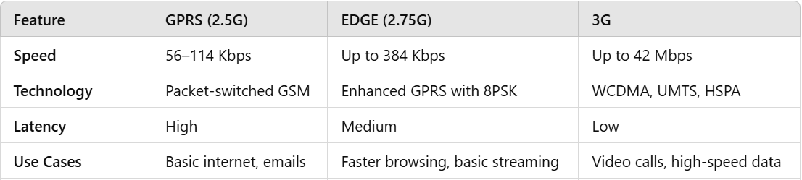
Cellular Provider and Technology:
For the first three generations of data services—GPRS- (General Packet Radio Service), Edge (Enhanced Data rates for GSM Evolution), and 3G (Third Generation)—IPv4 is the base protocol version.
Consequently, if IPv6 is used with these generations, it must be tunneled over IPv4.
On 4G/LTE networks, data services can use IPv4 or IPv6 as a base protocol, depending on the provider.

Slide 19
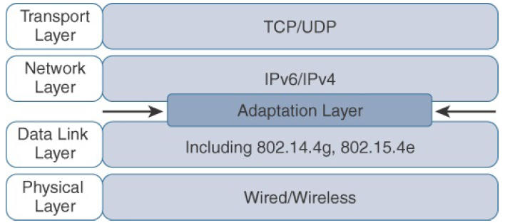
Optimizing IP for IoT
Internet Protocol is key for a successful Internet of Things, constrained nodes and constrained networks mandate optimization at various layers and on multiple protocols of the IP architecture.
The following sections introduce some of these optimizations already available from the market or under development by the IETF.
Figure highlights the TCP/IP layers where optimization is applied.
Optimizing IP for IoT Using an Adaptation Layer

Slide 20
From 6LoWPAN to 6Lo
The model for packaging IP into lower-layer protocols is often referred to as an adaptation layer.
The Adaptation Layer is responsible for bridging different network technologies, ensuring that higher-layer protocols (like IP) can work efficiently over lower-layer communication technologies (such as wireless, IoT, or sensor networks).
IP adaptation layers are typically defined by an IETF working group and released as a Request for Comments (RFC).
An RFC is a publication from the IETF that officially documents Internet standards, specifications, protocols, procedures, and events.
For example, RFC 864 RFC 864 defines the Character Generator Protocol (CHARGEN), a simple protocol for testing and debugging network connections. It describes how an IPv4 packet gets encapsulated over an Ethernet frame, and RFC 2464 describes how the same function is performed for an IPv6 packet.

Slide 21
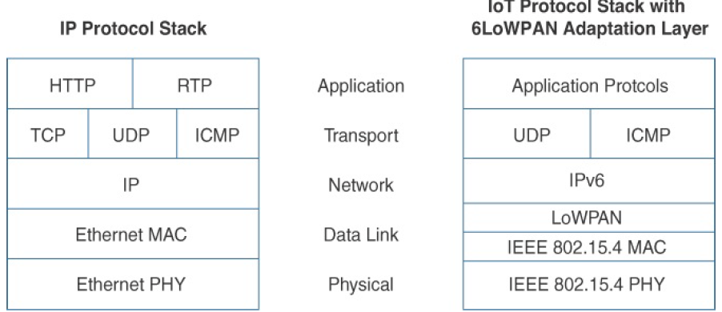
The main difference is that an adaptation layer designed for IoT may include some optimizations to deal with constrained nodes and networks.
The main examples of adaptation layers optimized for constrained nodes or “things” are the ones under the 6LoWPAN working group and its successor, the 6Lo working group.
The initial focus of the 6LoWPAN working group was to optimize the transmission of IPv6 packets over constrained networks such as IEEE 802.15.4.
Figure shows an example of an IoT protocol stack using the 6LoWPAN adaptation layer beside the well-known IP protocol stack for reference.
Comparison of an IoT Protocol Stack Utilizing 6LoWPAN and an IP Protocol Stack

Slide 22
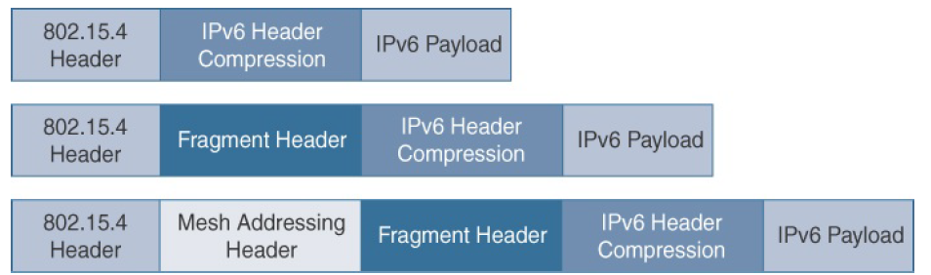
The 6LoWPAN working group RFC 4994 is foundational because it defines frame headers for the capabilities of header compression, fragmentation, and mesh addressing.
These headers can be stacked in the adaptation layer to keep these concepts separate while enforcing a structured method for expressing each capability.
Figure shows some examples of typical 6LoWPAN header stacks.
Figure shows the subheaders related to compression, fragmentation, and mesh addressing.
Figure: 6LoWPAN Header Stacks

Slide 23
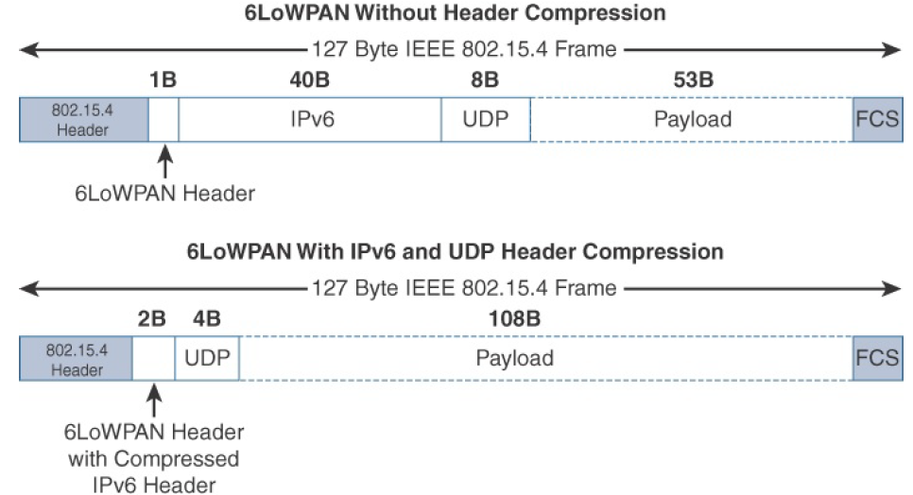
Header Compression
IPv6 header compression for 6LoWPAN was defined initially in RFC 4944 and subsequently updated by RFC 6282. This capability shrinks the size of IPv6’s 40-byte headers and User Datagram Protocol’s (UDP’s) 8-byte headers down as low as 6 bytes.
Figure. 6LoWPAN Header Compression

Slide 24
The full 40- byte IPv6 header and 8-byte UDP header is shown in top fig.
The 6LoWPAN header is only a single byte in next fig.
Notice that uncompressed IPv6 and UDP headers leave only 53 bytes of data payload out of the 127- byte maximum frame size in the case of IEEE 802.15.4.
The bottom half of fig. shows a frame where header compression has been enabled for a best-case scenario.
The 6LoWPAN header increases to 2 bytes to accommodate the compressed IPv6 header, and UDP has been reduced in half, to 4 bytes from 8.
Most importantly, the header compression has allowed the payload to more than double, from 53 bytes to 108 bytes, which is obviously much more efficient

Slide 25
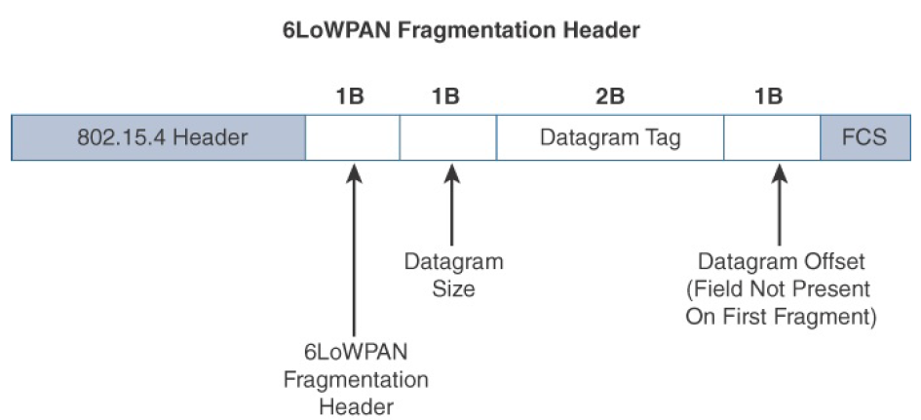
Fragmentation
The maximum transmission unit (MTU) for an IPv6 network must be at least 1280 bytes. The term MTU defines the size of the largest protocol data unit that can be passed.
For IEEE 802.15.4, 127 bytes is the MTU.
This is a problem because IPv6, with a much larger MTU, is carried inside the 802.15.4 frame with a much smaller one. To remedy this situation, large IPv6 packets must be fragmented across multiple 802.15.4 frames at Layer 2.
Figure. 6LoWPAN Fragmentation Header

Slide 26
In Figure, the 6LoWPAN fragmentation header field itself uses a unique bit value to identify that the subsequent fields behind it are fragment fields as opposed to another capability, such as header compression.
Also, in the first fragment, the Datagram Offset field is not present because it would simply be set to 0.
This results in the first fragmentation header for an IPv6 payload being only 4 bytes long.
The remainder of the fragments have a 5-byte header field so that the appropriate offset can be specified.

Slide 27
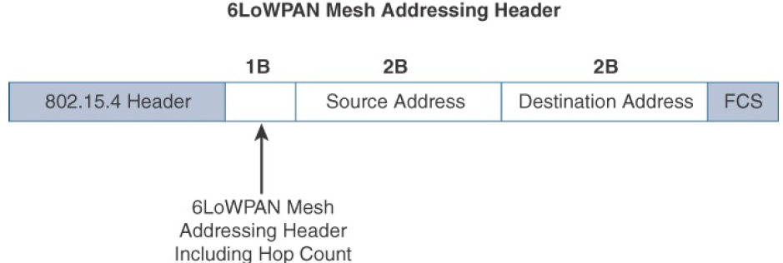
Mesh Addressing
The purpose of the 6LoWPAN mesh addressing function is to forward packets over multiple hops.
Three fields are defined for this header: Hop Limit, Source Address, and Destination Address.
The hop limit for mesh addressing also provides an upper limit on how many times the frame can be forwarded.
Each hop decrements this value by 1 as it is forwarded.
Once the value hits 0, it is dropped and no longer forwarded.
The Source Address and Destination Address fields for mesh addressing are IEEE 802.15.4 addresses indicating the endpoints of an IP hop. Figure details the 6LoWPAN mesh addressing header fields.
Figure 6LoWPAN Mesh Addressing Header

Slide 28
Mesh-Under Versus Mesh-Over Routing
Mesh-Under Routing: In mesh-under routing, the 6LoWPAN adaptation layer is responsible for forwarding packets at the link layer (L2), meaning that the IP layer sees the entire multi-hop path as a single IP hop. This approach simplifies the network layer (L3) and can be beneficial in resource-constrained environments, such as low-power and lossy networks (LLNs) used in IoT applications.
Advantages
Lower IP Stack Overhead: Since routing happens at L2, there’s no need for IP-layer routing mechanisms (e.g., RPL), reducing header overhead.
Faster Packet Forwarding: Packets are forwarded at the link-layer without invoking network-layer decisions, leading to lower processing delays.
Energy Efficiency: Reduces the energy consumption of constrained nodes by avoiding network-layer routing complexities.
Simplified IP Layer: The IP layer only sees one hop, making integration with IPv6 easier.

Slide 29
Mesh-Over Routing
On the other hand, mesh-over (or route-over) uses standard IP routing mechanisms, meaning that each node acts as an IP router, and packets are forwarded based on IP addresses rather than link-layer addressing. This approach aligns better with traditional IPv6 networks but can introduce more overhead due to the need for full IP stack processing at each hop.
IP Routing at Layer 3 (Network Layer)
IP-layer routing computes reachability and forwards packets.
Routing decisions are made using IP addresses rather than link-layer addresses.
Each Node is an IP Router
Every node in the LoWPAN must be able to process and forward IP packets.
This increases overhead since each hop requires full IPv6 header processing.
Supports Multi-Link Technologies
Route-over is useful when different link-layer technologies (e.g., IEEE 802.15.4, Wi-Fi, Ethernet) are used within the same LoWPAN.
Unlike mesh-under, where all routing happens at the link layer, route-over allows seamless integration with other IP-based networks.

Slide 30
6Lo Working Group (6LoWG)
The 6Lo Working Group (6LoWG) is an IETF (Internet Engineering Task Force) working group that focuses on adapting IPv6 to constrained-node networks (low-power, low-data-rate networks).
The name "6Lo" comes from "IPv6 over" various link-layer technologies.
Purpose of 6LoWG
The 6Lo Working Group is responsible for defining how IPv6 can efficiently work over different low-power and lossy networks (LLNs).
It extends the work of 6LoWPAN (RFC 4944) to additional link-layer technologies beyond IEEE 802.15.4.

Slide 31
1. Enable IPv6 over different link-layer technologies
Originally, IPv6-over-6LoWPAN was designed for IEEE 802.15.4 (low-power wireless networks).
The 6Lo Working Group expanded IPv6 support to other link-layer protocols.
2. Optimize header compression and adaptation layers
IPv6 headers are too large for constrained networks (due to the 40-byte header).
6LoWG develops compression techniques (e.g., RFC 6282 for header compression).
3. Address management and autoconfiguration
Defines methods for IPv6 address assignment and neighbor discovery (ND).

Slide 32
4. Support different link-layer technologies
The group defines IPv6-over-foo specifications for multiple technologies:
RFC 4944 → IPv6-over-IEEE 802.15.4 (6LoWPAN)
RFC 6282 → Header compression for 6LoWPAN
RFC 7668 → IPv6-over-Bluetooth Low Energy (BLE)
RFC 6775 → Optimized Neighbor Discovery for 6LoWPAN
RFC 8576 → IPv6-over-TSCH (Time-Slotted Channel Hopping)
RFC 8925 → IPv6-over-PLC (Power Line Communication)
5. Support for security mechanisms
Ensuring that IPv6 can be used securely in constrained networks.
IPv6-over-foo" is a general way of describing how IPv6 is transported over different types of network technologies

Slide 33
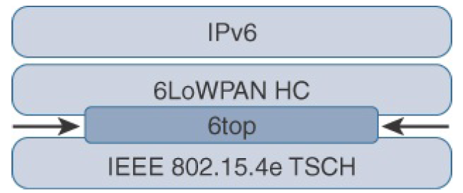
6TiSCH
6TiSCH (IPv6 over the Time-Slotted Channel Hopping mode of IEEE 802.15.4e) is an IETF Working Group focused on combining IPv6 networking with the IEEE 802.15.4e TSCH (Time-Slotted Channel Hopping) link-layer mechanism.
It is designed for industrial IoT (IIoT) and low-power wireless networks that require high reliability, low latency, and energy efficiency.
Location of 6TiSCH’s 6top Sublayer

Slide 34
Uses TSCH for Deterministic Networking
  Time-Slotted Channel Hopping (TSCH) is a MAC layer mechanism in IEEE 802.15.4e that schedules communication in time slots.
  TSCH improves latency, reliability, and interference resistance in low-power wireless networks.
IPv6 + 6LoWPAN Adaptation
  Uses 6LoWPAN (RFC 4944) to adapt IPv6 to IEEE 802.15.4e TSCH networks.
  Supports header compression (RFC 6282) for efficiency.
RPL for Routing
  Uses RPL (Routing Protocol for Low-Power and Lossy Networks, RFC 6550) for route-over multi-hop communication.
  Forms a deterministic mesh network for industrial applications.
Deterministic Scheduling
  Uses a centralized (or distributed) scheduler to allocate time slots for communication.
  Ensures real-time packet delivery with minimal collisions.
Energy Efficiency & Security
  Devices can enter low-power sleep modes between time slots.
  Supports security mechanisms for authentication and encryption.

Slide 35
RPL
The IETF chartered the RoLL (Routing over Low-Power and Lossy Networks) working group to evaluate all Layer 3 IP routing protocols and determine the needs and requirements for developing a routing solution for IP smart objects.
The RPL specification was published as RFC 6550 by the RoLL working group.
In an RPL network, each node acts as a router and becomes part of a mesh network. Routing is performed at the IP layer.
Each node examines every received IPv6 packet and determines the next-hop destination based on the information contained in the IPv6 header.
No information from the MAC-layer header is needed to perform next-hop determination.

Slide 36
To cope with the constraints of computing and memory that are common characteristics of constrained nodes, the protocol defines two modes:
1. Storing mode: All nodes contain the full routing table of the RPL domain. Every node knows how to directly reach every other node.
2. Non-storing mode: Only the border router(s) of the RPL domain contain(s) the full routing table.
All other nodes in the domain only maintain their list of parents and use this as a list of default routes toward the border router.
This abbreviated routing table saves memory space and CPU.
When communicating in non-storing mode, a node always forwards its packets to the border router, which knows how to ultimately reach the final destination.

Slide 37
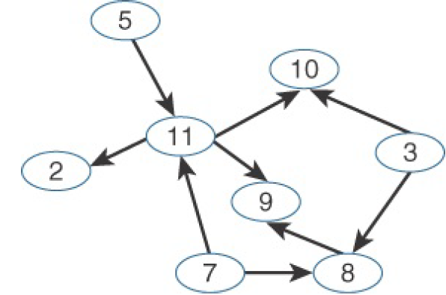
RPL is based on the concept of a directed acyclic graph (DAG).
A DAG is a directed graph where no cycles exist.
This means that from any vertex or point in the graph, you cannot follow an edge or a line back to this same point. All of the edges are arranged in paths oriented toward and terminating at one or more root nodes. Figure shows a basic DAG.
Example of a Directed Acyclic Graph (DAG)

Slide 38
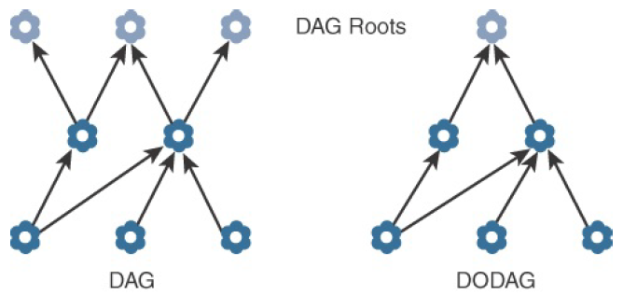
A basic RPL process involves building a destination-oriented directed acyclic graph (DODAG). A DODAG is a DAG rooted to one destination.
In RPL, this destination occurs at a border router known as the DODAG root.
Figure compares a DAG and a DODAG. You can see that that a DAG has multiple roots, whereas the DODAG has just one.
DAG and DODAG Comparison

Slide 39
In a DODAG, each node maintains up to three parents that provide a path to the root.
Typically, one of these parents is the preferred parent, which means it is the preferred next hop for upward routes toward the root.
The routing graph created by the set of DODAG parents across all nodes defines the full set of upward routes.
RPL protocol implementation should ensure that routes are loop free by disallowing nodes from selected DODAG parents that are positioned further away from the border router.

Slide 40
RPL Messages:
DIO (DODAG Information Object) – Upward Route Advertisement
  Used by the root (border router) to broadcast routing information downward to nodes.
  Nodes use DIO messages to join a DODAG (Directed Acyclic Graph).
  Helps establish the upward route (from nodes to the border router).
DAO (Destination Advertisement Object) – Downward Route Advertisement
  Used by nodes to send routing updates back to the root.
  Helps establish downward routes (for communication from the border router to nodes).
  Nodes send DAOs to advertise their presence and reachable destinations.
DIS (DODAG Information Solicitation) – Request for DIO Messages
  Sent by nodes when they want to join the network but haven't received a DIO yet.
  Triggers a DIO response from neighboring nodes.
  This bidirectional communication enables RPL’s upward and downward routing, allowing sensor nodes to communicate with the Internet and vice versa.

Slide 41
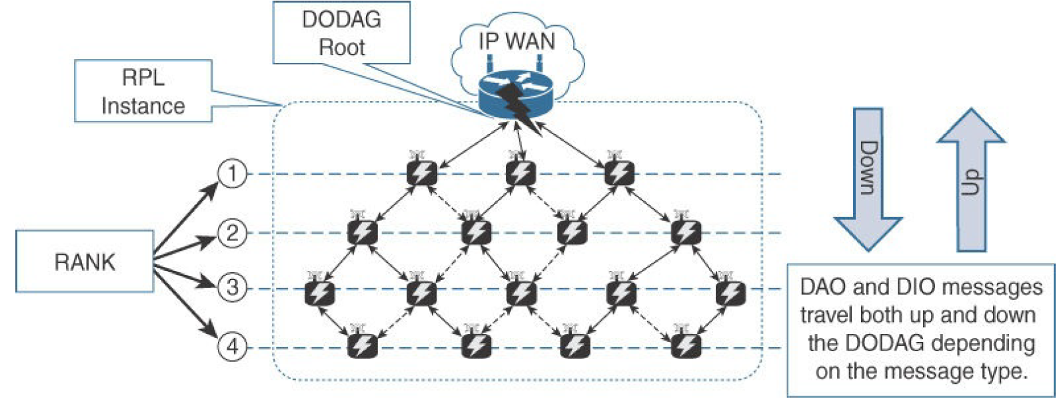
RPL messages, such as DIO and DAO, run on top of IPv6. These messages exchange and advertise downstream and upstream routing information between a border router and the nodes under it.
As illustrated in Figure, DAO and DIO messages move both up and down the DODAG, depending on the exact message type.
Figure RPL Overview

Slide 42
Objective Function (OF) in RPL
The Objective Function (OF) in RPL (Routing Protocol for Low-Power and Lossy Networks, RFC 6550) defines how nodes evaluate potential parents and compute their rank in the DODAG (Destination-Oriented Directed Acyclic Graph).
The OF determines the best path based on metrics such as link quality, hop count, or energy consumption.

Slide 43
Characteristics of Objective Functions:
Used for Parent Selection & Rank Computation
  Each node chooses its preferred parent based on the OF's metric(s).
  The rank of a node represents its distance (cost) from the root (border router).
  A lower rank means the node is closer to the root.
Defined in Standard RFCs
  RFC 6552 – Objective Function Zero (OF0) (Default, hop-count-based).
  RFC 6719 – Minimum Expected Number of Transmissions (METX).
  Vendors and researchers can define custom OFs to optimize RPL for specific applications.

Slide 44
Rank in RPL (Routing Protocol for Low-Power and Lossy Networks)
In RPL (RFC 6550), rank is a key concept used to represent the distance (or cost) of a node from the root (border router) in a DODAG (Destination-Oriented Directed Acyclic Graph).

Slide 45
Characteristics of Rank in RPL
Prevents Routing Loops
  Ensures nodes always move "downward" in the DODAG.
  A node can only select a parent with a lower rank to avoid loops.
Changes Dynamically
  Increases if a node receives a DIO message with a larger version number.
  Decreases if a lower-cost route is found.
Different from Routing Metrics
  Rank ≠ Routing Metric (e.g., ETX, RSSI).
  Rank is a constraint to maintain DAG structure, while routing metrics optimize path selection.

Slide 46
RPL Headers in IPv6
RPL (Routing Protocol for Low-Power and Lossy Networks, RFC 6550) introduces specific network layer headers to manage routing within an RPL domain.
These headers help with loop detection, source routing, and efficient data forwarding in LLNs (Low-Power and Lossy Networks).
RPL Headers (RFC 6553 & RFC 6554)
RFC | Header Name | Function
RFC 6553 | RPL Option (RPL Hop-by-Hop Header) | Loop detection and RPL instance management
RFC 6554 | RPL Source Routing Header (SRH) | Supports source routing in non-storing mode

Slide 47
1. RFC 6553 – RPL Option (Hop-by-Hop Header)
Introduces a new IPv6 Hop-by-Hop option called the RPL Option.
Used to carry RPL-related information in data packets within an RPL domain.
Helps detect routing loops by checking RPL instance information.
Fields in the RPL Option Header:
Flags: Control bits for RPL-specific behaviors.
RPL Instance ID: Identifies the RPL instance.
Sender Rank: Helps detect and prevent loops.
O (OAM) Bit: Used for Operations, Administration, and Maintenance (OAM).

Slide 48
2. RFC 6554 – RPL Source Routing Header (SRH)
Defines a new IPv6 Routing Header for source routing in RPL.
Used in RPL Non-Storing Mode, where the root precomputes the path and sends it in the packet header.
How SRH Works in RPL Non-Storing Mode:
The root (border router) computes the entire path to the destination.
The path is added to the Source Routing Header (SRH).
Intermediate nodes read and forward the packet based on the SRH.

Slide 49
RPL Routing Metrics & Constraints (RFC 6551)
RPL (Routing Protocol for Low-Power and Lossy Networks) is designed for low-power and lossy networks (LLNs), which include a mix of battery-powered and mains-powered nodes.
To optimize routing, RFC 6551 defines a comprehensive set of metrics and constraints that help RPL nodes select the best path in a DODAG (Destination-Oriented Directed Acyclic Graph).

Slide 50
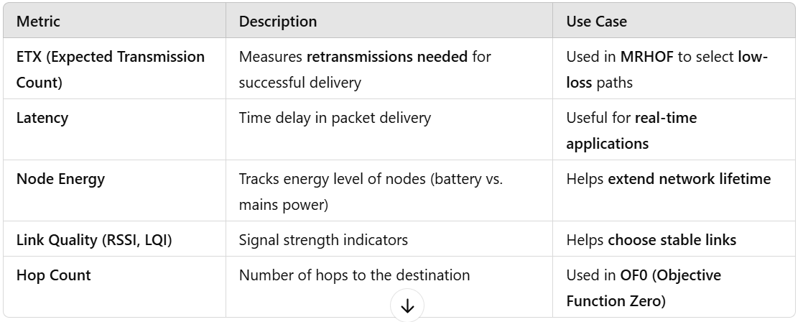
1. Routing Metrics (Used for Path Selection)
Routing metrics in RPL quantify link/node quality and help select the most efficient path.
Some key metrics include:

Slide 51
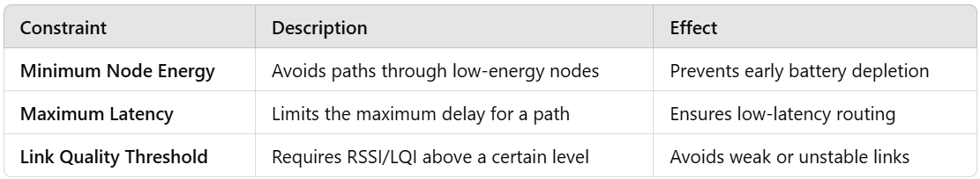
2. Routing Constraints (Used to Filter Out Paths)
Routing constraints restrict paths that do not meet certain requirements.
Some key constraints include:

Slide 52
Authentication and Encryption on Constrained Nodes
IETF working groups that are focused on IoT security: ACE and DICE.
ACE (Authentication and Authorization for Constrained Environments)
The ACE (Authentication and Authorization for Constrained Environments) Working Group is responsible for adapting authentication and authorization mechanisms for low-power, constrained networks, such as 6LoWPAN, RPL, and CoAP-based IoT systems.

Slide 53
ACE Working Group
Evaluate existing authentication and authorization protocols for suitability in LLNs (Low-Power and Lossy Networks).
Develop a secure framework for access control in IoT environments.
Focus on CoAP + DTLS (Datagram Transport Layer Security) for security, ensuring lightweight, encrypted communication.
Enable resource access (GET, PUT, POST, DELETE) via secure methods.
Work on interoperability between CoAP-DTLS and HTTP-TLS for seamless IoT security.

Slide 54
How ACE Secures Constrained IoT Networks
The ACE framework introduces a centralized authorization model using an Authorization Server (AS) to mediate access between Client, Resource Server, and AS.
Key Components in ACE Security Model
Component | Role
Client (C) | Requests access to a resource (e.g., sensor data)
Resource Server (RS) | Hosts protected resources (e.g., an IoT device)
Authorization Server (AS) | Grants access tokens to clients
Access Token | Used by the client to prove authorization
CoAP is used for resource access, while DTLS secures the communication between nodes.

Slide 55
DICE (DTLS In Constrained Environments)
DICE (DTLS In Constrained Environments) is an IETF working group focused on optimizing DTLS (Datagram Transport Layer Security) for constrained nodes and networks.
It ensures that CoAP-based IoT applications can use secure communication efficiently.

Slide 56
DICE & DTLS Optimizations for IoT
Since DTLS is originally designed for traditional IP networks, it needs modifications for constrained environments:
Optimization | Description
DTLS Record Layer Compression | Reduces packet size for constrained networks (6LoWPAN).
Lightweight Handshakes | Avoids full key exchanges for every new session.
Session Resumption | Allows nodes to reconnect without redoing authentication.
Elliptic Curve Cryptography (ECC) | Uses small keys for fast encryption on constrained devices.
CoAP-DTLS Integration | Ensures secure communication for CoAP messages.

Slide 57
Profiles and Compliances in IoT Constrained Networks
Since IoT constrained nodes rely on multiple protocols working together (6LoWPAN, RPL, CoAP, DTLS, etc.), profiles, certifications, and compliance frameworks help ensure interoperability, security, and reliability.

Slide 58
IPSO (Internet Protocol for Smart Objects) Alliance
The IPSO Alliance, established in 2008, promotes the use of IP (Internet Protocol) for smart objects in IoT networks.
Instead of defining new protocols, IPSO focuses on validating interoperability, documenting best practices, and educating engineers on how to build IP-based IoT solutions.

Slide 59
Wi-SUN Alliance
The Wi-SUN (Wireless Smart Ubiquitous Networks) Alliance is an industry-driven organization focused on defining communication profiles for secure, IPv6-based wireless networks.
It primarily supports the IEEE 802.15.4g standard and enables multiservice, energy-efficient networking over UDP-based transport.
Thread: IPv6-Based Wireless Mesh Networking
The Thread Group is an industry consortium that defines Thread, an IPv6-based, low-power, wireless mesh networking protocol.
It is designed for smart home, building automation, and consumer IoT applications.

Slide 60
IPv6 Ready Logo Program
The IPv6 Ready Logo Program was created by the IPv6 Forum to ensure that IPv6 implementations are interoperable and conform to industry standards.
This certification program helps increase user confidence in IPv6 adoption by verifying protocol compliance and interoperability.

Slide 61
5.3 Transporting Higher-Layer IoT Protocols
1. Introduction
Importance of efficient transport in IoT networks
Choosing the right transport protocol impacts latency, reliability, security, and power consumption.
Challenges in constrained environments (low power, lossy networks, etc.)
2. The Transport Layer in IoT
TCP vs. UDP in IoT
  Reliability vs. efficiency trade-offs
  When to use TCP (e.g., MQTT over TCP)
  When to use UDP (e.g., CoAP over UDP)
Lightweight Transport Alternatives
  Datagram Transport Layer Security (DTLS) for UDP security
  Quick UDP Internet Connections (QUIC) as a TCP alternative

Slide 62
3. IoT Application Transport Methods
Message Queue Telemetry Transport (MQTT)
  TCP-based, publish-subscribe model
  Use cases: Remote monitoring, industrial IoT
Constrained Application Protocol (CoAP)
  UDP-based, lightweight RESTful communication
  Use cases: Sensor data exchange, smart homes
Data Distribution Service (DDS)
  Real-time, peer-to-peer communication
  Use cases: Robotics, autonomous vehicles
Advanced Message Queuing Protocol (AMQP)
  Reliable messaging for enterprise IoT
  Use cases: Cloud-to-device communication
Lightweight M2M (LwM2M)
  Device management and telemetry for constrained devices
4. Comparison of Transport Methods
  Latency, reliability, and overhead trade-offs
  Suitability for constrained networks

Slide 63
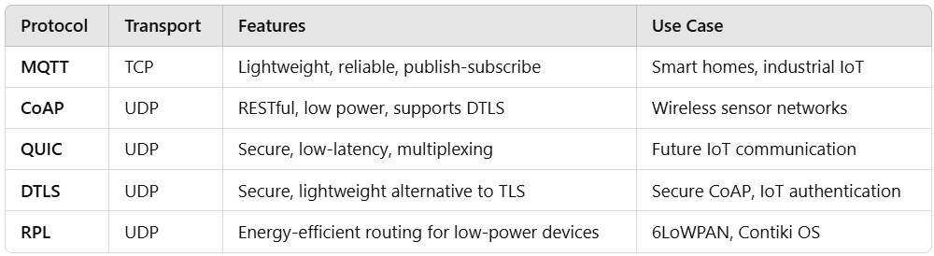

Slide 64
The Transport Layer
Selection of a protocol for the transport layer as supported by the TCP/IP architecture in the context of IoT networks.
With the TCP/IP protocol, two main protocols are specified for the transport layer:
Transmission Control Protocol (TCP): This connection-oriented protocol requires a session to get established between the source and destination before exchanging data. It as equivalent to a traditional telephone conversation, in which two phones must be connected and the communication link established before the parties can talk.
User Datagram Protocol (UDP): With this connectionless protocol, data can be quickly sent between source and destination—but with no guarantee of delivery. This is analogous to the traditional mail delivery system, in which a letter is mailed to a destination. Confirmation of the reception of this letter does not happen until another letter is sent in response.

Slide 65
TCP in IoT Transport Layer
Advantages of TCP in IoT
Reliable Data Delivery – TCP ensures all packets reach their destination and are reassembled in order.
Error Correction – Lost or corrupted packets are retransmitted, preventing data loss.
Flow Control – TCP adjusts the data transmission rate according to network conditions.
Congestion Control – It prevents excessive data from overwhelming the network.
Ordered Data Transmission – Data packets arrive in sequence, making it ideal for applications requiring structured data.
Challenges of Using TCP in IoT
High Overhead – TCP headers add extra bytes, increasing bandwidth usage.
Latency Issues – Retransmissions and acknowledgments (ACKs) introduce delays.
Connection-Oriented – TCP requires a three-way handshake, consuming additional time and power.
Not Ideal for Low-Power Devices – Battery-powered IoT sensors may struggle with TCP’s complexity.
When to Use TCP in IoT
Applications requiring guaranteed delivery (e.g., firmware updates, file transfers).
Remote monitoring systems where data integrity is critical.
IoT devices communicating with cloud services over Wi-Fi or Ethernet.

Slide 66
UDP in IoT Transport Layer
Advantages of UDP in IoT
Low Latency – Since UDP does not require acknowledgments or retransmissions, it is faster than TCP.
Low Overhead – The UDP header is only 8 bytes, reducing bandwidth consumption.
Best for Real-Time Communication – Voice, video, and sensor data can be transmitted with minimal delay.
No Connection Setup – Unlike TCP, UDP does not require a handshake, making it more efficient for short-lived transmissions.
Challenges of Using UDP in IoT
No Built-in Reliability – Packets may be lost, duplicated, or arrive out of order.
No Congestion Control – UDP does not adjust the transmission rate based on network conditions.
Packet Loss Can Occur – There is no automatic retransmission of lost packets.
When to Use UDP in IoT
Lightweight and real-time applications (e.g., sensor data streaming, real-time monitoring).
IoT protocols like CoAP and MQTT-SN, which implement their own reliability mechanisms.
Broadcast and multicast applications, such as discovery protocols.

Slide 67
Generic Web-Based Protocols
Many IoT devices rely on widely used transport technologies found in consumer and enterprise networks.
These protocols are suited for non-constrained environments with stable connectivity.
Common Transport Methods:
  HTTP(S) over TCP – Used for RESTful APIs, smart home devices, and cloud integration.
  WebSockets over TCP – Real-time bidirectional communication (e.g., smart dashboards, live monitoring).
  4G/LTE and Wi-Fi – Common in smart home and enterprise IoT applications.
Use Cases:
  Cloud-connected smart home devices.
  Industrial IoT systems with high-bandwidth requirements.

Slide 68
IoT Application Layer Protocols: CoAP and MQTT
For constrained networks and large-scale IoT deployments, traditional web-based protocols like HTTP can be too resource-intensive. Instead, lightweight IoT-specific protocols such as CoAP (Constrained Application Protocol) and MQTT (Message Queuing Telemetry Transport) are widely used.
In Figure, CoAP and MQTT are naturally at the top of this sample IoT stack, based on an IEEE 802.15.4 mesh network.
CoAP deployed over UDP and
MQTT running over TCP.
Example of a High-Level IoT Protocol Stack for CoAP and MQTT

Slide 69
Constrained Application Protocol (CoAP)
CoAP is a lightweight application-layer protocol designed for constrained devices and networks. It is developed by the IETF Constrained RESTful Environments (CoRE) working group to support resource-oriented applications in IoT.
Features of CoAP
Lightweight & Efficient – Optimized for low-power devices and lossy networks.
Request-Response Model – Works like HTTP but over UDP for reduced overhead.
RESTful Architecture – Uses GET, POST, PUT, DELETE methods like HTTP.
Supports Asynchronous Communication – Uses Observe (RFC 7641) for real-time updates.
Security – Uses DTLS (Datagram Transport Layer Security) for encryption.
Supports Block-wise Transfers – Handles large payloads efficiently (RFC 7959).
Interoperability with HTTP – Can be mapped to HTTP (RFC 8075).

Slide 70
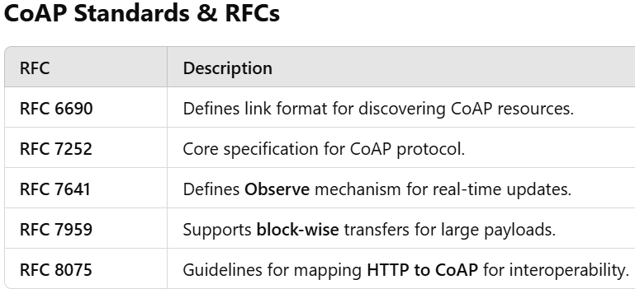

Slide 71
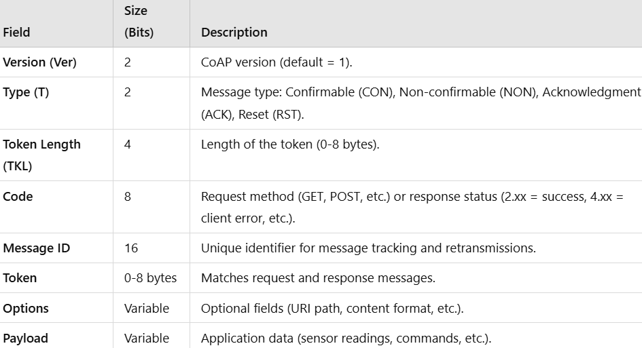
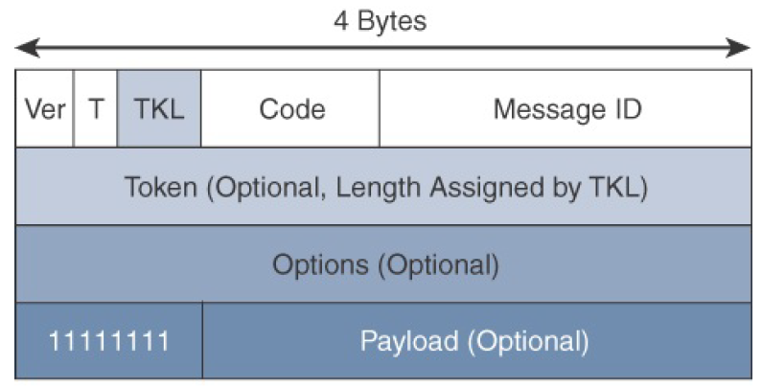
CoAP Message Format Overview
CoAP uses a compact and efficient message format to reduce overhead and optimize communication in constrained IoT environments.
A CoAP message consists of a fixed 4-byte header followed by optional fields.

Slide 72
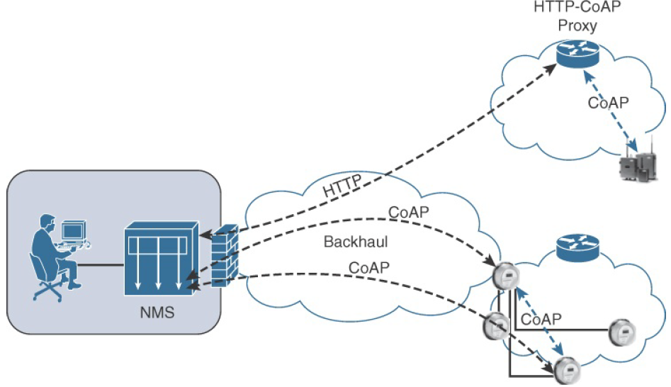
As illustrated in Figure, CoAP communications across an IoT infrastructure can take various paths.
Connections can be between devices located on the same or different constrained networks or between devices and generic Internet or cloud servers, all operating over IP. Proxy mechanisms are also defined, and RFC 7252 details a basic HTTP mapping for CoAP.
CoAP Communications in IoT Infrastructures

Slide 73
Message Queuing Telemetry Transport (MQTT)
MQTT is a lightweight, publish-subscribe messaging protocol designed for low-bandwidth, high-latency, and unreliable networks. It is ideal for IoT devices that need efficient, real-time communication.
Features of MQTT:
Low Bandwidth Usage (Minimal overhead in messages)
Efficient Power Consumption (Ideal for battery-powered devices)
Reliable Communication (QoS levels ensure message delivery)
Supports Unreliable Networks (Works over TCP, WebSockets, and even via cellular networks)

Slide 74
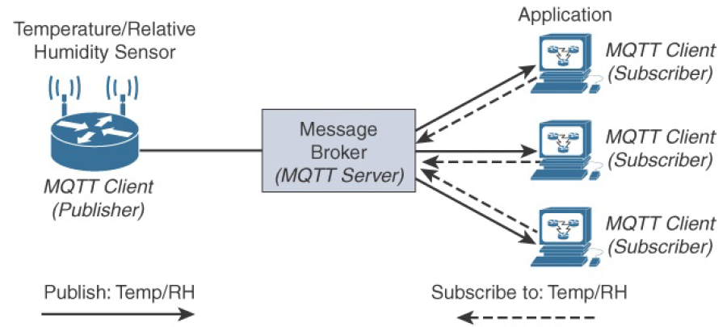
MQTT Communication Model in IoT
MQTT (Message Queuing Telemetry Transport) follows a publish-subscribe model, making it highly efficient for IoT applications that require real-time data transmission.
🔹 Publishers – IoT devices (e.g., sensors) that send data to a broker.
🔹 Brokers – Central servers that receive, filter, and distribute messages.
🔹 Subscribers – Applications or devices that receive data by subscribing to specific topics.

Slide 75
Temperature & Humidity Sensor (Pub-Sub Model)
Publisher (Sensor): Sends Temp/RH data to the broker.
Broker (MQTT Server): Routes the message to subscribers.
Subscriber (Dashboard/App): Receives the Temp/RH data and updates the UI.
Similar to Twitter:
A user (subscriber) follows a topic.
The topic publishes updates.
The follower receives new posts automatically.

Slide 76
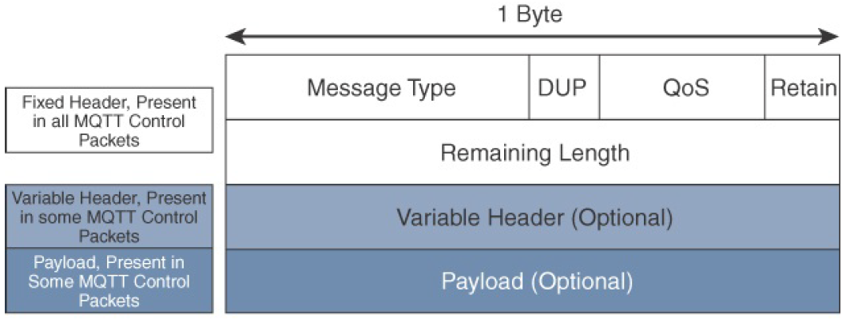
MQTT Message Format
MQTT is lightweight because each control packet has a 2-byte fixed header and optional components. However, it can still handle large payloads (up to 256 MB) for diverse IoT applications.
Fixed Header (2 Bytes, Required)
🔹 First Byte:
4-bit Control Packet Type (CONNECT, PUBLISH, SUBSCRIBE, etc.).
4-bit Flags (QoS, DUP, RETAIN).
🔹 Second Byte:
Remaining Length (size of variable header + payload).
Variable Header (Optional)
Packet Identifier – Used for QoS 1 and QoS 2 messages.
Topic Name – Present in PUBLISH messages.
Return Code – Used in CONNACK (Connection Acknowledgment).
Payload (Optional, Up to 256 MB)
Used in PUBLISH, SUBSCRIBE, CONNECT packets.
Contains sensor readings, JSON data, or binary files.

Slide 77
Advanced Message Queuing Protocol (AMQP)
AMQP (Advanced Message Queuing Protocol) is a binary, application-layer protocol for message-oriented communication. It provides reliable, secure, and interoperable messaging between distributed systems.
Features of AMQP:
Reliable Message Delivery (Guaranteed delivery using message queues)
Interoperability (Works across different platforms and technologies)
Security (Supports encryption & authentication)
Asynchronous Communication (Efficient for distributed applications)

Slide 78
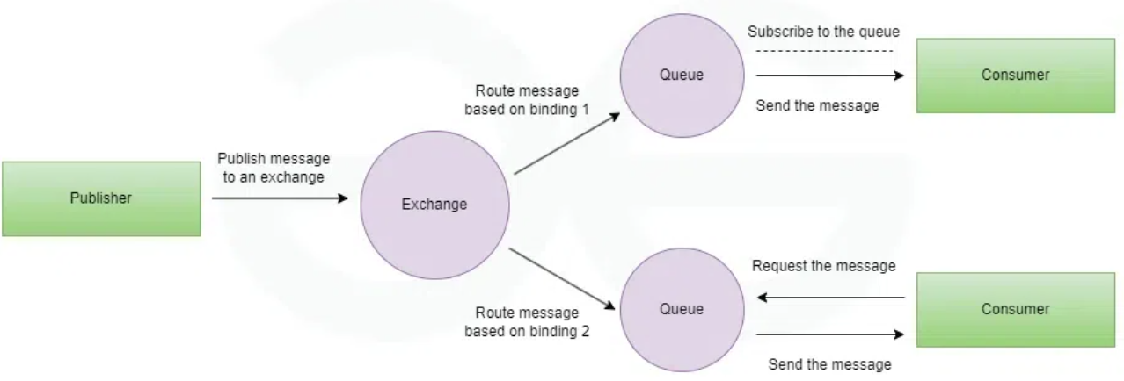

Slide 79
Components of AMQP
Exchanges: The exchange is responsible for fetching messages and properly arranging them in the appropriate queue
Channel: A channel is a multiplexed virtual connection between AMQP peers that is built into an existing connection.
Message Queue: It is a unique entity that connects messages to their resources or points.
Binding: Bindings are a set of predetermined instructions for queuing and exchanging. It manages message transmission and delivery.
Virtual Host: Vhost is a platform that provides isolation capabilities within the broker. Multiple vhosts may be functional at the same time, depending on the users and their access rights.

Slide 80
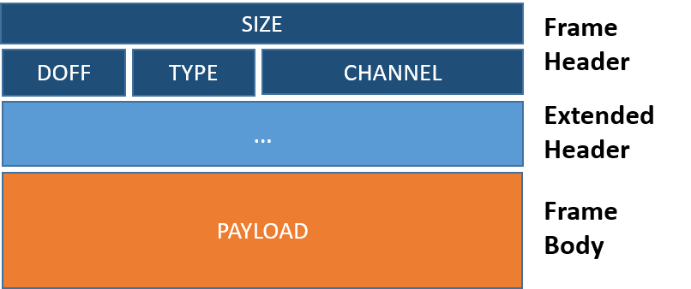
AMQP Message Format
Frame header: The header has a fixed size (8 bytes), and it is mandatory, as it contains the information needed to parse the rest of the frame itself—for example the total frame size and the frame type.
Extended header: A variable header that depends on the frame type.
Frame body: A sequence of bytes that has a format that depends on the frame type.

